Slide 1
Team Too
Mike Bogochow
Dan Bolan
Kevin Conley
Chris Len

Slide 2

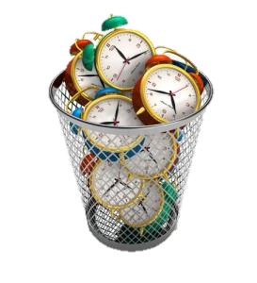
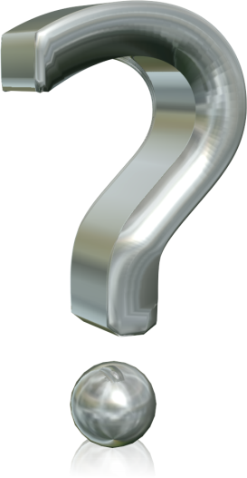
What’s the problem?
+
=

Slide 3
How did we fix it?
Our app sifts through documents that a user uploads and finds keywords
These key words are then displayed in an easy to read format, so that the user can decide whether it is a worthwhile read

Slide 4
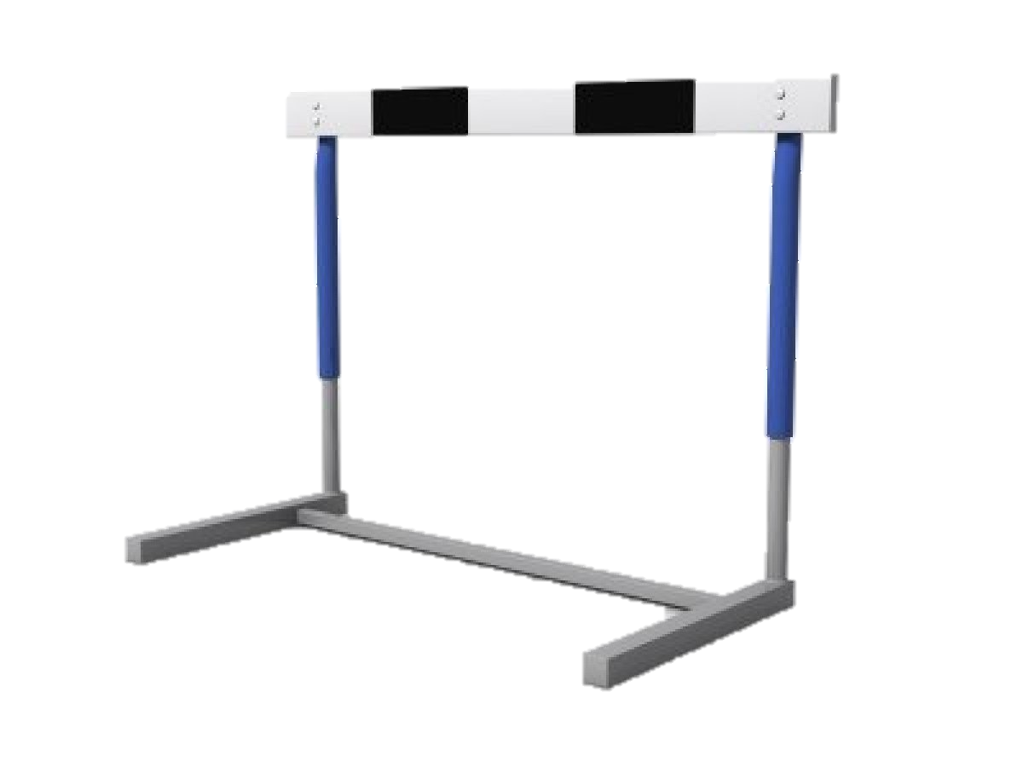
How did we do it? Why was it hard?
Too

Slide 5
http://www.getvector.info/cartoon-vector-illustration-of-a-book-open/
http://www.dorm-room-biz.com/2012/06/01/social-networking-a-waste-of-time-or-time-well-spent/
http://www.geeklawblog.com/2011/12/end-of-traditional-billing-with-no.html

